Slide 1
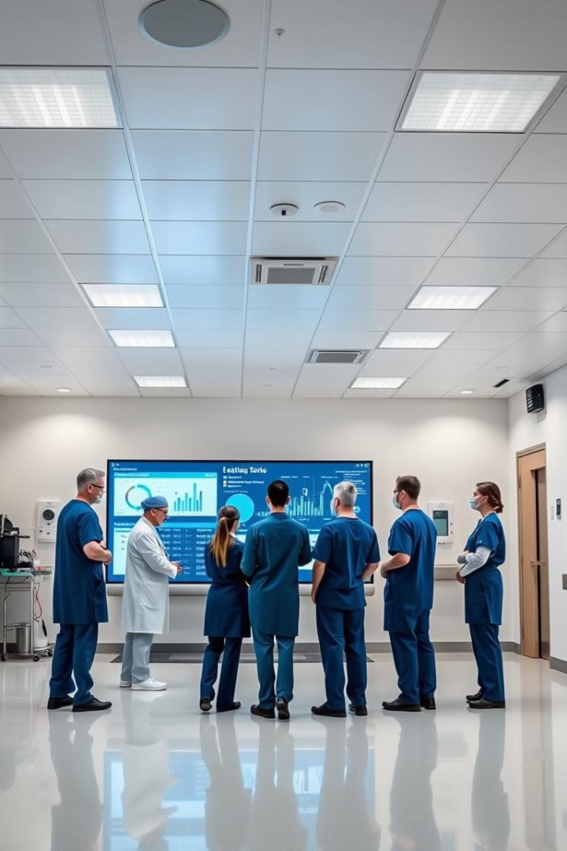
Big Data In Healthcare
A Case Study Presentation on Narayana Health.
By Group 4
Rahul Sanatan Behara
Vikas Chauhan
Prateek Bajpai
Utkarsh Shejwal
Ritesh Salunkhe
Sumit Singh
Shashank Shetwe
Jay Savane

Slide 2
Introduction to Big Data in Healthcare
Harnessing Data
Challenges
Opportunities
Vast amounts of structured (EHRs) and unstructured data (images, notes).
Complex data integration from disparate sources.
Precision medicine: personalized treatment plans.
Maintaining patient privacy (HIPAA compliance).
Population health management: identifying at-risk individuals.
NLP extracts insights from unstructured data.
Scalability and real-time processing of massive datasets.
Drives innovation and improves patient care.
Predictive modeling: proactive interventions and resource allocation.

Slide 3
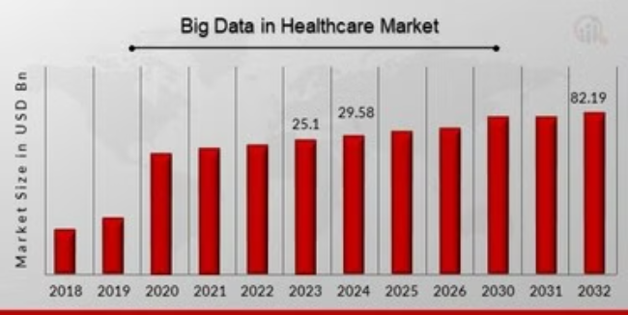
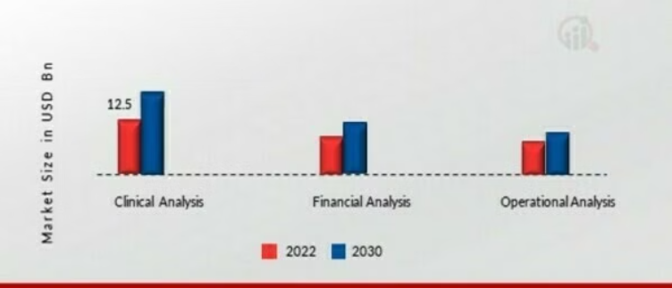
Healthcare Market Insights
Big Data in Healthcare
Big Data in Healthcare by Applications
The global big data healthcare market is experiencing rapid growth, driven by advancements in analytics and cloud technologies.
The chart showcases overall market trends and application-specific contributions from 2022 to 2030, highlighting Clinical, Financial and Operational Analysis growth.

Slide 4
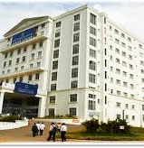
Narayana Health
Established in 2000: Narayana Health focuses on affordable, technology-driven healthcare.
Advanced Analytics: Utilizes cloud and big data for real-time decision-making.
Medha Platform: In-house tool for streamlined data insights and operational efficiency.
Virtual Trials: Leverages historic data for precision medicine and cost-effective research.
Real-Time Monitoring: Implements Power BI dashboards for dynamic performance tracking.

Slide 5
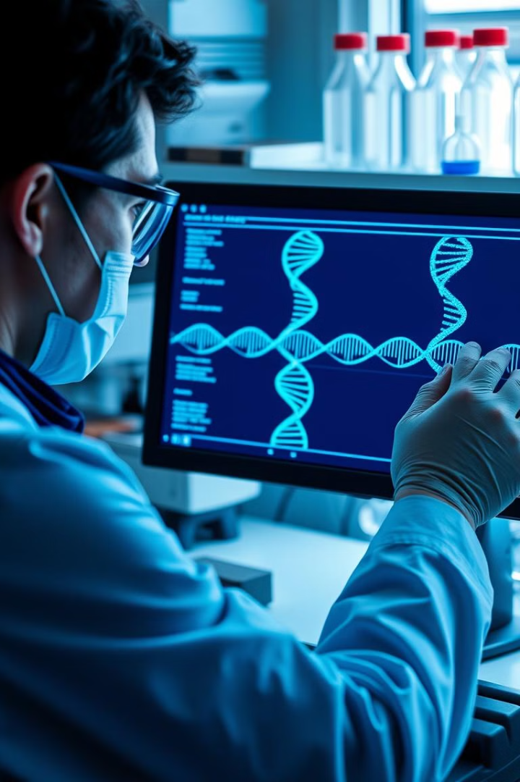

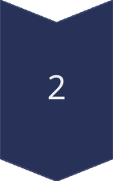
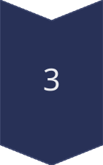
The Role of Precision Medicine
Genomic Data
Analyzing genomic data can help identify genetic markers and tailor treatments to individual patients.
Predictive Analytics
Predictive models can forecast disease risk and guide preventive care strategies.
Personalized Therapies
Precision medicine enables the development of targeted drugs and therapies for specific patient populations.

Slide 6
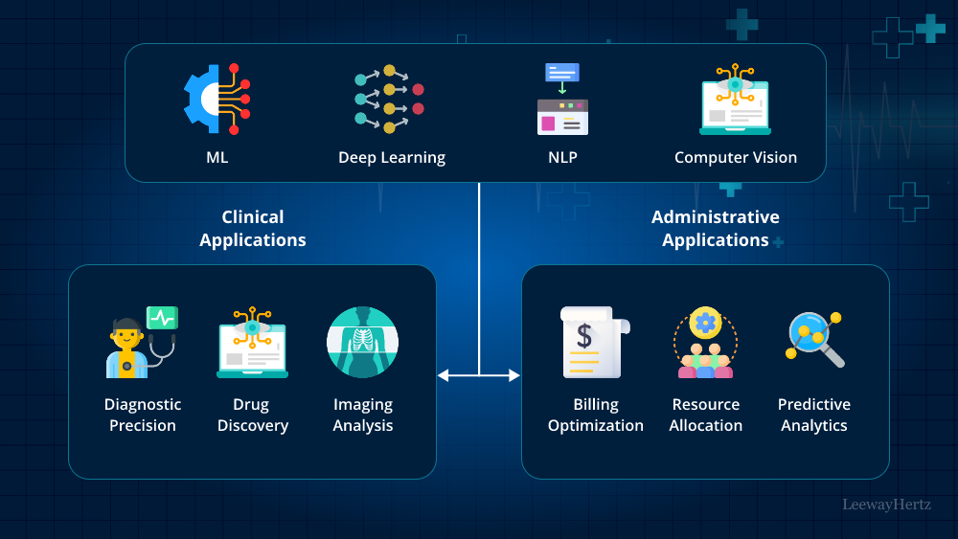
Process Flowchart

Slide 7
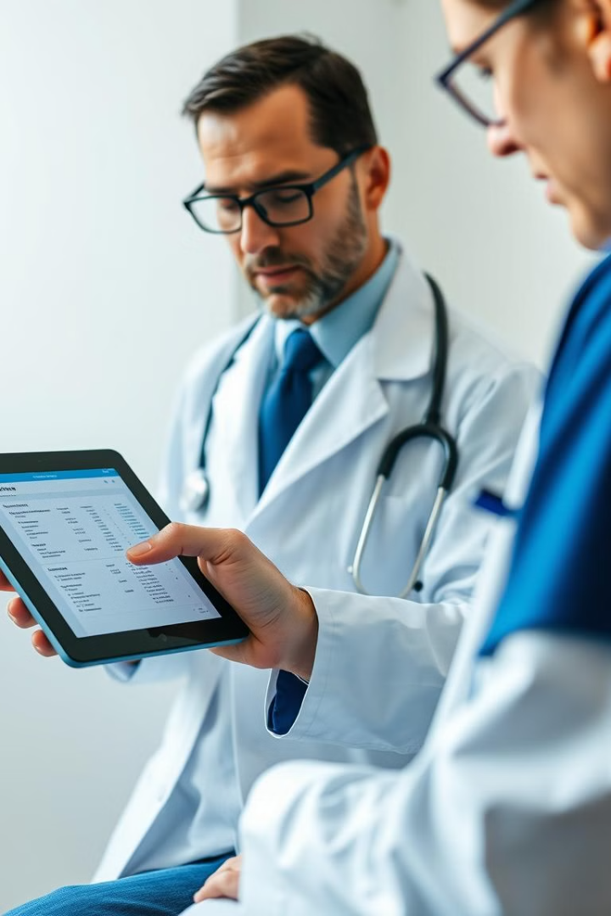
Leveraging Electronic Health Records
1
Cloud Usage
2
Clinical Insights
Cloud-based systems for storing and accessing clinical data.
Analyzing EHR data to uncover trends, identify risk factors, and inform clinical decision-making.
3
Population Health
Using EHR data to monitor population health, track disease outbreaks, and allocate resources more effectively.

Slide 8
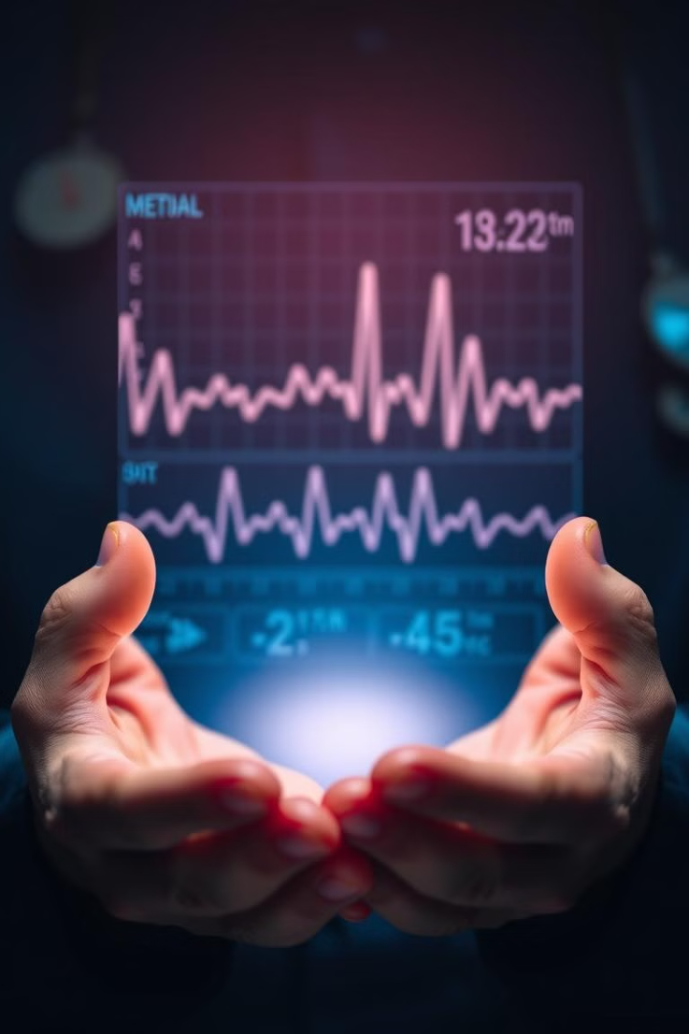
Ensuring Privacy of Medical Information
Regulatory Compliance
Encryption & Access Controls
Adherence to data privacy laws, such as HIPAA, to protect the confidentiality of patient information.
Implementing robust security measures to safeguard sensitive data and limit access to authorized personnel.
Patient Consent
Obtaining explicit patient consent for the use and sharing of their medical data to build trust and transparency.

Slide 9

Balancing Aggregation and Sharing of Records
1
Data Aggregation
Combining data from multiple sources to gain a comprehensive understanding of patient populations and healthcare trends and integrating with their MEDHA app.
2
Secure Sharing
Enabling the secure sharing of de-identified data with researchers, policymakers, and other stakeholders to drive innovation.
3
Ethical Considerations
Ensuring the ethical use of patient data, respecting individual privacy, and maintaining public trust.

Slide 10





Importance of Transparency in Data Practices
1
Transparency
2
Accountability
3
Trust
4
Improved Outcomes
5
Patient-Centric Care
Fostering transparency in data practices, including data collection, usage, and sharing, is crucial for building patient trust, ensuring accountability, and ultimately improving healthcare outcomes.

Slide 11
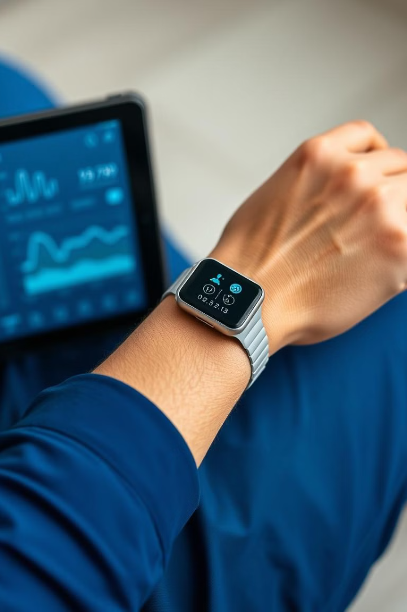



Leveraging Medical Device Wearables for Efficiency
Remote Monitoring
Wearable devices can continuously track patient vitals and activity, enabling remote monitoring and early intervention.
Predictive Analytics
Data from wearables can be analyzed to predict and prevent potential health issues, optimizing care delivery.
Process Optimization
Integrating wearable data with electronic health records can streamline workflows and improve operational efficiency.

Slide 12

Improving Patient Outcomes and Reducing Costs
70%
20%
Reduced Man-Hours
Reduction in Time for Management Reviews
15%
ICU
Improved Nursing Workflow
Shortened ICU Stays
Narayana Health enhanced nursing efficiency using data visualization tools, reduced reporting time with real-time analytics, & streamlined ICU stays through patient monitoring. Centralized dashboards provided rapid access to key metrics, improving decision-making & minimizing delays across operations.

Slide 13
References
How Narayana Health Uses Big Data.
https://news.microsoft.com/en-in/features/narayana-health-uses-data-analytics-and-ai-to-provide-affordable-high-quality-healthcare/
https://cio.economictimes.indiatimes.com/news/next-gen-technologies/narayana-health-looks-at-tech-to-make-healthcare-affordable-for-all-vice-chairperson-viren-prasad-shetty/93916095
Flowchart
https://www.leewayhertz.com/ai-use-cases-in-healthcare/#how-does-ai-in-healthcare-work
Analytics
https://www.marketresearchfuture.com/reports/global-big-data-healthcare-market-948

Slide 14
THANK YOU

